Slide 1
Chapter 11
Behavior and Animation
Resumes of the book
Computer Graphics using Java 2D and 3D
Computação Gráfica
Prof. Carlos Carreto
Engenharia Informática
Instituto Politécnico da Guarda

Slide 2
Objectives
Understand the concept and methods for implementing 3D animations.
Understand and create Alpha objects.
Apply multiple types of interpolators to create animations.
Create morphing with Morph knots and behaviors.
Using LOD behaviors
Use billboard behaviors

Slide 3
Animation
An animation consists of dynamic changes of a scene over time.
Changes may involve different attributes of the scene, such as geometries, transformations, position, color, and transparency.

Slide 4
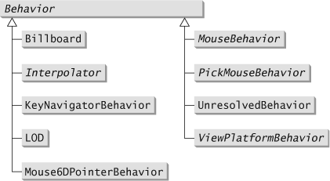
Animation
The Java 3D API extensively allows the implementation of animations in a scene through the Behavior class and its implementations.
A family of classes known as Interpolators encapsulate common animation actions.

Slide 5
Animation
The Alpha class, which represents a time function, serves as the "driving force" for Interpolators.
In practice, creating an animation consists of creating the appropriate interpolator object, attaching an Alpha object to it, and connecting the interpolator to the target object that we want to animate.
BG
rotator
TG
. . .
alpha

Slide 6
Animation
The Java 3D API also supports other animation-related techniques such as morphing, level of detail (LOD), and billboard.

Slide 7
Alpha Objects
An animation consists of dynamic changes of a scene over time.
An Alpha object defines a time function that generates values between 0.0 and 1.0 that serve as input to an interpolator object responsible for the dynamic change of the scene.
An Alpha object functions acts as a clock signal generator that dictates the time sequence of the dynamic change of the scene.

Slide 8
Alpha Objects
It controls the object TG in order to implement a rotation about the Y axis, interpolating the rotation angle between 0º and 360º.
BG
rotator
TG
alpha
Box
Controls the angle interpolation, generating values from 0.0 to 1.0, over a given time interval. At each instant, the interpolator uses the generated value to determine the angle value (0.0 -> 0º, 1.0 -> 360º).

Slide 9

Alpha Objects
The time function generated by an Alpha object is defined by a set of parameters:

Slide 10
Alpha Objects
loopCont - Number of pulses or periods. The value -1 indicates an unlimited number of periods.
1
2
…

Slide 11
Alpha Objects
startTime - Absolute time for the initial reference point.

Slide 12
Alpha Objects
triggerTime - Time in milliseconds from startTime to the activation of the Alpha object.

Slide 13
Alpha Objects
phaseDelayDuration - Time in milliseconds for the initial wait from triggerTime.

Slide 14
Alpha Objects
alphaAtZeroDuration - Time in milliseconds during which the Alpha value is 0.0.

Slide 15
Alpha Objects
alphaAtOneDuration - Time in milliseconds during which the Alpha value is 1.0.

Slide 16
Alpha Objects
increasingAlphaDuration - Time in milliseconds for the Alpha value increase from 0.0 to 1.0.

Slide 17
Alpha Objects
decreasingAlphaDuration -
Time in milliseconds for the Alpha value to decrease from 1.0 to 0.0.

Slide 18
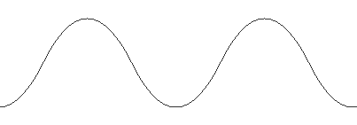
Alpha Objects
increasingAlphaRampDuration: Time in milliseconds for the alpha value to accelerate during the increment phase.
decreasingAlphaRampDuration: Time in milliseconds for the alpha value to accelerate during the decrement phase.

Slide 19
Alpha Objects
Different constructors for Alpha objects:
public Alpha()
public Alpha(int loopCount, long increasingAlphaDuration)
public Alpha(int loopCount,
long triggerTime,
long phaseDelayDuration,
long increasingAlphaDuration,
long increasingAlphaRampDuration,
long alphaAtOneDuration)
public Alpha(int loopCount, int mode,
long triggerTime, long phaseDelayDuration,
long increasingAlphaDuration,
long increasingAlphaRampDuration,
long alphaAtOneDuration,
long decreaingAlphaDuration,
long dereasingAlphaRampDuration,
long alphaAtZeroDuration)

Slide 20
Alpha Objects
The mode parameter can have the values INCREASING_ENABLE, DECREASING_ENABLE, or a OR combination of the two.
INCREASING_ENABLE activates the parameters related to the increment of the alfa value.
DECREASING_ENABLE activates the parameters related to the decrement of the alfa value.

Slide 21
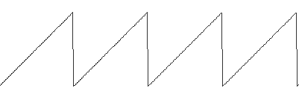
Alpha Objects
Default values:
loopCount : -1
mode : INCREASING_ENABLE
startTime : system start time
triggerTime : 0
phaseDelayDuration : 0
increasingAlphaDuration : 1000
increasingAlphaRampDuration : 0
alphaAtOneDuration : 0
decreasingAlphaDuration : 0
decreasingAlphaRampDuration : 0
alphaAtZeroDuration : 0
isPaused : false
pauseTime : 0
Time function of the Alpha object with the default values.

Slide 22
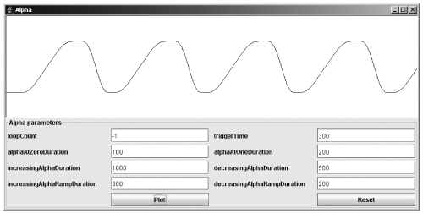
Alpha Objects
Code
Run

Slide 23
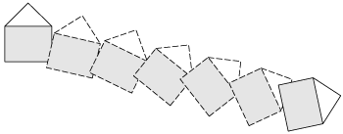
Interpolators
Specify a range of values for a given attribute that defines the animation.
Perform interpolation of the intermediate values.
Are driven by Alpha objects that define how the variation in the range of values is made.
Act on attributes such as color, switches, transparency and geometric transformations.

Slide 24
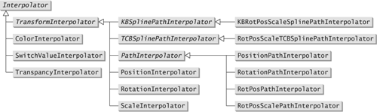
Interpolator Classes

Slide 25
Interpolator Classes

Slide 26
ColorInterpolator Classe
Interpolation between two color values of an object of type Material.
Example:
Alpha alpha = new Alpha();
Material material = new Material();
Color3f red = new Color3f(1f, 0f, 0f);
Color3f green = new Color3f(1f, 0f, 0f);
ColorInterpolator ci = new ColorInterpolator(alpha, material, red, green);
ci.setSchedulingBounds(new BoundingSphere());

Slide 27
TransformInterpolator Classes

Slide 28
TransformInterpolator Classes
They act on a TransformGroup object.
Contain a Transform3D object to transform the actuation axis.
RotationInterpolator - Interpolation between two angles (around YY axis).
PositionInterpolator - Interpolation between two positions (along XX axis).
ScaleInterpolator – Interpolation between two scale values.

Slide 29
RotationInterpolator Classes
Used in the demonstrations of previous chapters to create the animation of rotation around the Y axis.
By default the axis of rotation is the Y axis and the interpolation interval goes from 0 ° to 360 °.
TransformGroup tg = new TransformGroup()
root.addChild(tg);
. . .
Alpha alpha = new Alpha(-1, 4000);
RotationInterpolator rotator = new RotationInterpolator
(alpha, tg);
rotator.setSchedulingBounds(new BoundingSphere());
root.addChild(rotator);

Slide 30
PathInterpolator Classes

Slide 31
PathInterpolator Classes
Define a path to the animation by specifying a sequence of control points or key frames.
Perform linear interpolation of the intermediate points between each pair of adjacent points.
The timing of the interpolation with respect to Alpha values is controlled by a sequence of numbers called knots.

Slide 32
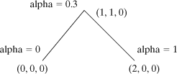
PositionPathInterpolator Classe
Point3f[] positions = {new Point3f(0,0,0),
new Point3f(1,1,0), new Point3f(2,0,0)};
float[] knots = {0f, 0.3f, 1f};
Alpha alpha = new Alpha();
TransformGroup target = new TransformGroup();
Transform3D axis = new Transform3D();
PositionPathInterpolator interpolator =
new PositionPathInterpolator(alpha, target, axis, knots, positions);
The positions array contains the points that define the path.

Slide 33
PositionPathInterpolator Classe
Point3f[] positions = {new Point3f(0,0,0),
new Point3f(1,1,0), new Point3f(2,0,0)};
float[] knots = {0f, 0.3f, 1f};
Alpha alpha = new Alpha();
TransformGroup target = new TransformGroup();
Transform3D axis = new Transform3D();
PositionPathInterpolator interpolator =
new PositionPathInterpolator(alpha, target, axis, knots, positions);
The knots array contains the alpha values for each point in the path, thereby controlling the movement along the path.

Slide 34
KBSplinePathInterpolator and TCBSplinePathInterpolator Classes

Slide 35
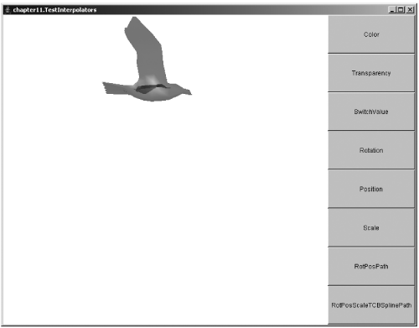
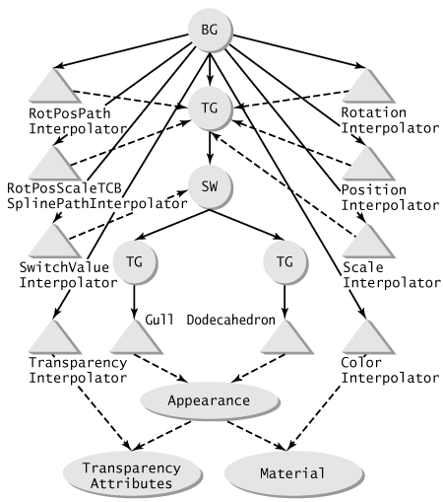
Demonstration of the Interpolators
Code
Run

Slide 36
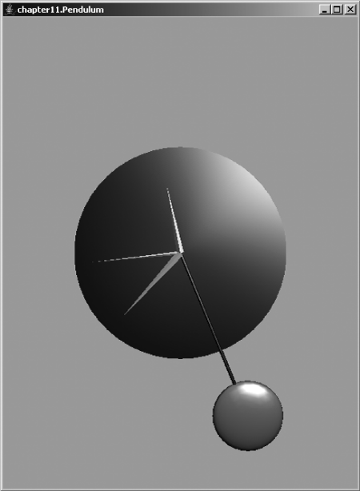
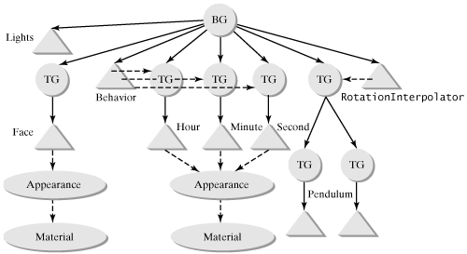
Demonstration of the Interpolators
Code
Run

Slide 37
Demonstration of the Interpolators
// pendulum
. . .
TransformGroup tgSwing = new TransformGroup(); tgSwing.setCapability(TransformGroup.ALLOW_TRANSFORM_WRITE);
. . .
Alpha alpha = new Alpha(-1, Alpha.INCREASING_ENABLE | Alpha.DECREASING_ENABLE, 0,0, 500,0,0,500,0,0);
Transform3D trAxis = new Transform3D();
trAxis.rotX(Math.PI/2);
RotationInterpolator swing = new RotationInterpolator(alpha, tgSwing, trAxis, (float)(-Math.PI/6), (float)(Math.PI/6));
tgPend.addChild(swing);
swing.setSchedulingBounds(bounds);

Slide 38
Morphing
Animation technique that transforms an object into another by changing the geometry.
Applied through the Morph class (leaf node).
It is controlled by a personalized Behavior.
The Morph class has an array of geometries.
An array of weights is also defined.
The geometry of the Morph object is defined by the weighted sum of the geometries in the array.
Typically the weights are modified by a personalized Behavior in order to get an animation.

Slide 39
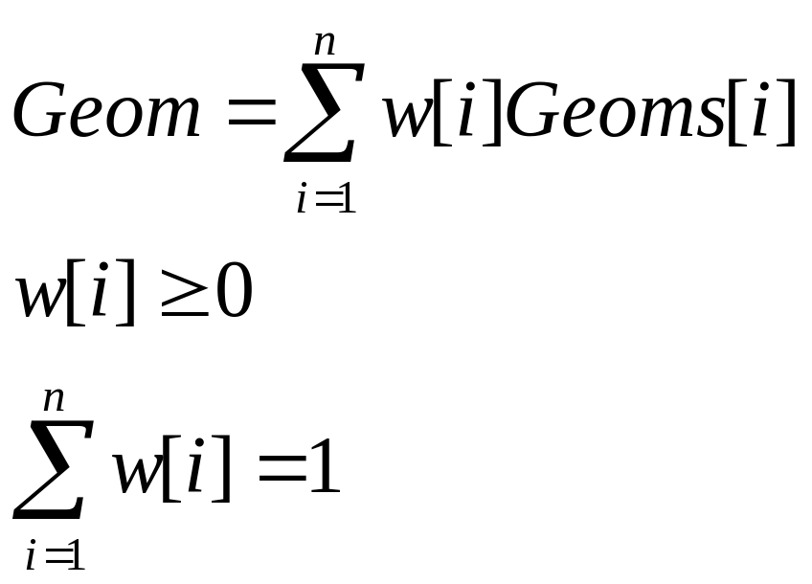
Weighted Sum of Geometries
At each moment, the object's current geometry is the weighted average of the set of defined geometries.
A custom Behavior object is used to change, over time, the weights used in the weighted average.

Slide 40
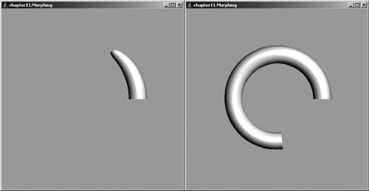
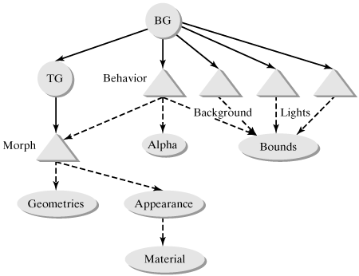
Morphing
Code 11.4
Code 11.5
Run

Slide 41
Morphing
public class MorphingBehavior extends Behavior {
Morph morph;
Alpha alpha;
public MorphingBehavior(Morph m, Alpha a) {
morph = m;
alpha = a;
}
public void initialize() {
wakeupOn(new WakeupOnElapsedFrames(10));
}
public void processStimulus(java.util.Enumeration enumeration) {
double[] w = new double[4];
double a = alpha.value();
w[0] = 0;
w[1] = 0;
w[2] = 0;
w[3] = 0;
int index = (int)(a*3);
if (index > 2) index = 2;
w[index+1] = (a-index/3.0)*3;
w[index] = 1.0-w[index+1];
morph.setWeights(w);
wakeupOn(new WakeupOnElapsedFrames(10));
}
}

Slide 42
Morphing
. . .
// geometry
GeometryArray[] geoms = new GeometryArray[4];
geoms[0] = createGeometry1(0.1);
geoms[1] = createGeometry1(0.7);
geoms[2] = createGeometry2(0.5);
geoms[3] = createGeometry2(0.8);
. . .
Morph morph = new Morph(geoms, appear);
morph.setCapability(Morph.ALLOW_WEIGHTS_READ);
morph.setCapability(Morph.ALLOW_WEIGHTS_WRITE);
. . .
// Behavior node
Alpha alpha = new Alpha(-1, Alpha.INCREASING_ENABLE|Alpha.DECREASING_ENABLE,
0,0, 8000,0,0,8000,0,0);
MorphingBehavior mb = new MorphingBehavior(morph, alpha);
. . .

Slide 43
LOD (Level Of Detail)
Useful technique to reduce the computational cost of rendering complex objects.
A visual object near the viewer will be larger and will show more detail than the same object seen from a distance.
Objects that are further away are then rendered with less resolution and less detail without significantly affecting quality.

Slide 44
LOD (Level Of Detail)
The LOD abstract class, subclass of the Behavior class, implements the LOD technique.
The DistanceLOD class implements the LOD class.
An LOD object acts on a list of Switch nodes to select a descendant of a Switch that corresponds to the level of detail desired.
The DistanceLOD class controls automatically the selection based on the distance from the object to the view of the scene.

Slide 45
LOD (Level Of Detail)
The DistanceLOD class has the following constructors:
  public DistanceLOD()
  public DistanceLOD(float[] distances)
  public DistanceLOD(float[] distances, Point3f position)
The distance array defines the critical distances to change the level of detail.
The default position for calculating the distance in sight is the position of the object. The third constructor allows you to specify a different position.

Slide 46
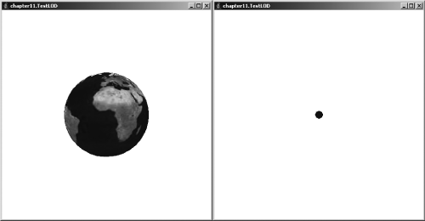
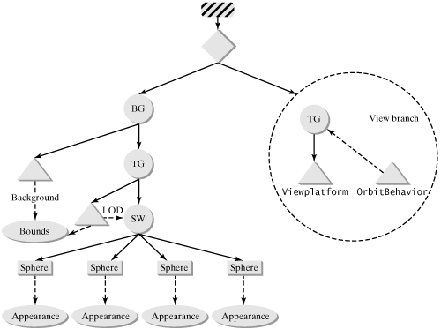
LOD (Level Of Detail)
Code
Run

Slide 47
LOD (Level Of Detail)
. . .
// a switch to hold the different levels
Switch sw = new Switch(0);
sw.setCapability(javax.media.j3d.Switch.ALLOW_SWITCH_READ);
sw.setCapability(javax.media.j3d.Switch.ALLOW_SWITCH_WRITE);
objTrans.addChild(sw);
// 4 levels of globes
loadImages();
Appearance ap = createAppearance(0);
sw.addChild(new Sphere(0.4f, Primitive.GENERATE_TEXTURE_COORDS, 40, ap));
ap = createAppearance(1);
sw.addChild(new Sphere(0.4f, Primitive.GENERATE_TEXTURE_COORDS, 20, ap));
ap = createAppearance(2);
sw.addChild(new Sphere(0.4f, Primitive.GENERATE_TEXTURE_COORDS, 10, ap));
ap = new Appearance();
ap.setColoringAttributes(new ColoringAttributes(0f,0f,0.5f,ColoringAttributes.FASTEST));
sw.addChild(new Sphere(0.4f, Sphere.GENERATE_NORMALS, 5, ap));
// the DistanceLOD behavior
float[] distances = new float[3];
distances[0] = 5.0f;
distances[1] = 10.0f;
distances[2] = 25.0f;
DistanceLOD lod = new DistanceLOD(distances);
lod.addSwitch(sw);

Slide 48
Billboard
It acts on a TransformGroup target object so that its descendants are always facing the view.
Useful for text captions.
Useful for simulating complex 3D scenes with 2D objects, such as images.

Slide 49
Billboard
The Billboard class has the following constructors:
  public Billboard()
  public Billboard(TransformGroup target)
  public Billboard(TransformGroup target, int mode, Point3f point)
  public Billboard(TransformGroup target, int mode, Vector3f axis)

Slide 50
Billboard
A Billboard object can work in two different modes:
  ROTATE_ABOUT_POINT - an arbitrary rotation is performed to ensure full alignment;
  ROTATE_ABOUT_AXIS - Alignment rotation is performed only in relation to a given axis (Y axis for example).

Slide 51
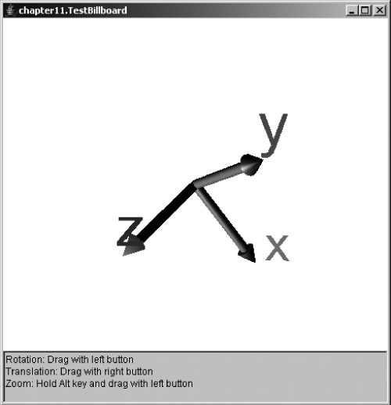
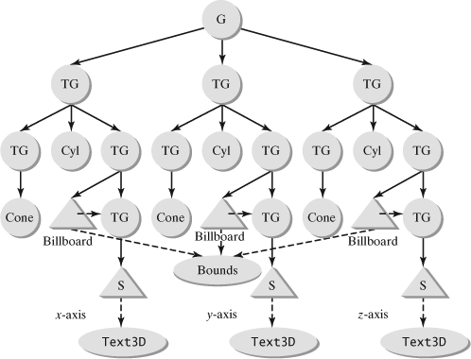
Billboard
Code 11.7
Code 11.8
Run

Slide 52
Billboard
. . .
// x axis
. . .
TransformGroup xTextTg = new TransformGroup(tTr);
TransformGroup bbTg = new TransformGroup();
bbTg.setCapability(TransformGroup.ALLOW_TRANSFORM_WRITE);
xTextTg.addChild(bbTg);
bbTg.addChild(xShape);
Billboard bb = new Billboard(bbTg, Billboard.ROTATE_ABOUT_POINT, new Point3f(0,0,0));
bb.setSchedulingBounds(bounds);
xTextTg.addChild(bb);

